Slide 1
Brain projects
2016-06-01

Slide 2
brain research projects
Human Connectome
Allen Brain Atlas
Brain Initiative
Blue Brain Project
BrainMaps
BrainMapping Foundation

Slide 3
overview of brain research projects
Human Connectome*
Allen Brain Atlas*
Brain Initiative
Blue Brain Project
BrainMaps
BrainMapping Foundation

Slide 4
allen brain atlas

Slide 5
Allen Brain Atlas
DATA
gene expression
mouse brain (adult, developing)
human brain (adult, developing)
connectivity — mouse brain
cell types — mouse brain

Slide 6
Allen Brain Atlas
Gene expression
Multimodal atlas
MRI, diffusion tensor imaging (DTI), histology, gene expression
Microarray data of gene expression
mapped to MRI

Slide 7
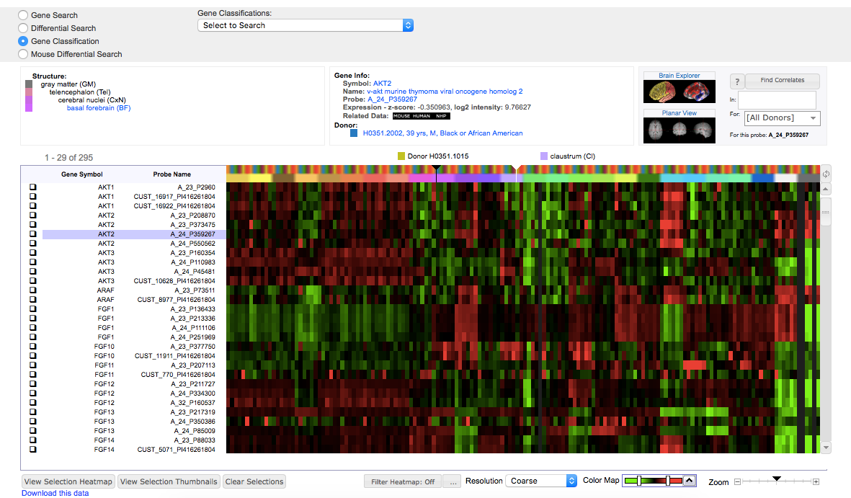
Allen Brain Atlas
Gene expression
Search by gene or anatomy
View gene info
View expression in 3D images

Slide 8
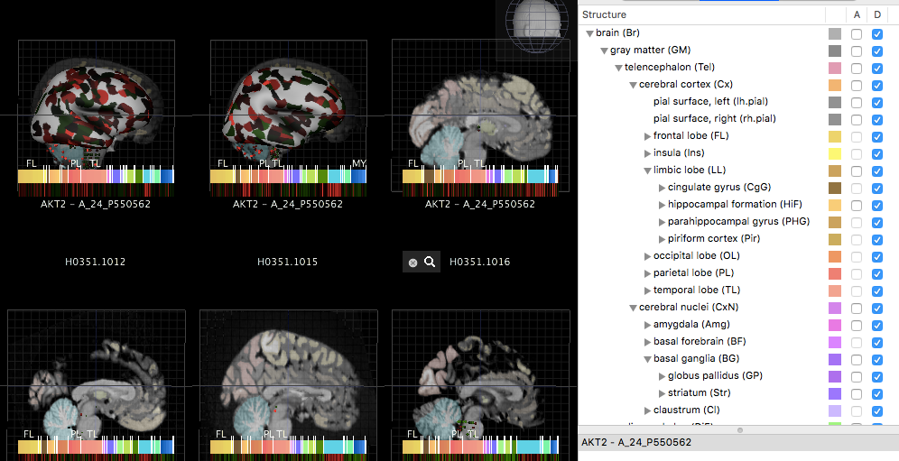
Allen Brain Atlas
Gene expression
Search by gene or anatomy
View gene info
View expression in 3D images

Slide 9
ALLEN BRAIN ATLAS
TOOLS
ALLEN SDK
in Python
Cell Types
Mouse Connectivity
API Access – retrieve data from the Atlas
Models – generated from electrophysiological data from the Cell Types database
Generalized Leaky Integrate-and-Fire & Biophysical

Slide 10
Allen SDK
CELL TYPES
cell types: access via Python
electrophysiology: whole cell current clamp recordings
morphological reconstruction: form, structure, features

Slide 11
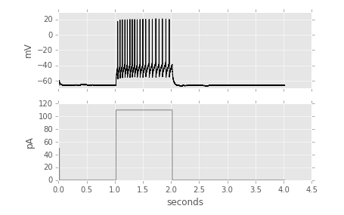
Allen SDK
Cell Type: Electrophysiology
whole cell current clamp recordings
voltage response —>
injected current —> stimulus

Slide 12
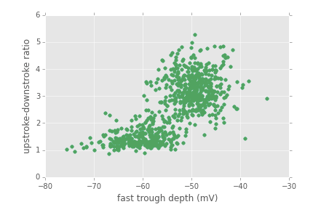
Allen SDK
Cell Type: Electrophysiology
Example of what you can do with the data—analyze one feature of one cell
Scatter plot of “upstroke-downstroke ratio” vs. “fast trough depth”

Slide 13
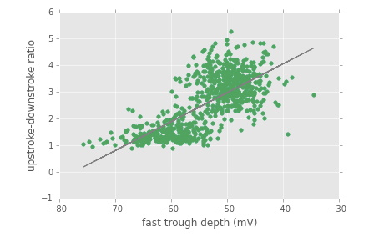
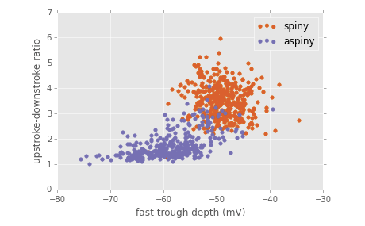
Allen SDK
Cell Type: Electrophysiology
Linear regression
Clustering

Slide 14
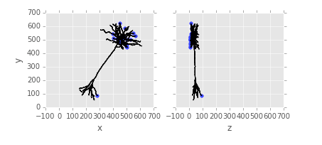
Allen SDK
Cell Type: Morphology
form, structure, features
a cell & a 3D location of its parts
soma, axon, basal & apical dendrites
called “compartments”
.swc format

Slide 15
Allen SDK
API Access to data
Cell Types
Biophysical
GLIF
Annotated Section Data Sets: experiments by intensity, density, pattern, age
Grid: 3D expression grids
ImageDownload
Mouse Connectivity

Slide 16
Allen SDK
API Access to data
Ontologies: neuroanatomical regions of interest
ConnectedServices: Allen Institute Pipeline services
RMA: general-purpose HTTP interface
SVG: annotations associated with images
Synchronization: data about image alignment
TreeSearch: ancestors/descendents of structure and specimen trees

Slide 17
allen SDK
MOUSE CONNECTIVITY
mouse brain connectivity atlas: Python
Experimental metadata, project signal volumes, structural annotations
Generate a matrix of projection density values in auditory sub-structures for cre-negative VISp experiments

Slide 18
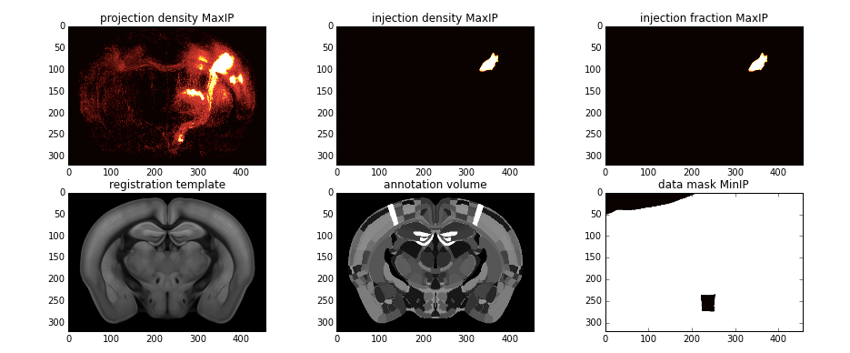
allen SDK
MOUSE CONNECTIVITY
Projection grid data volume

Slide 19
ALLEN BRAIN ATLAS
STATE OF THE ART
Prediction of the cell type distribution of age-related gene expression changes in the human brain
Expression analysis of genes expressed in bipolar cells in the retina
Examination of expression patterns of genes identified as regionally enriched by serial analysis of gene expression
Examination of genes that protect against α-synuclein misfolding in a Caenorhabditis elegans Parkinson's disease model
http://www.nature.com/nrn/journal/v10/n11/box/nrn2722_BX1.html

Slide 20
ALLEN BRAIN ATLAS
POSSIBLE RESEARCH QUESTIONS
Do particular genes lead to certain diseases?
What genes are expressed in certain parts of the brain? (e.g. retina)
Can developmental disorders be explained by some genes expressed during development? (We have developmental gene expression data)

Slide 21
Human connectome project

Slide 22
Human Connectome
Goal: map the human connectome
How?
Diffusion MRI—connections
resting-state fMRI
task fMRI (motor, memory, etc.)
some MEG & EEG
900 subject data release

Slide 23
MRI Data
1 subject: 40GB
900 subjects total
preprocessed & denoised
raw .nii files
Connectome Workbench
user interface to the data

Slide 24
human connectome
fmri tasks
Somatosensory, Motor—finger responses
Category-specific representations—faces, objects, animals, houses
Language processing—auditory sentence presentation with semantic, syntactic, and pragmatic violations
Social cognition— Frith-Happe animations of social & random interactions
other tasks…

Slide 25
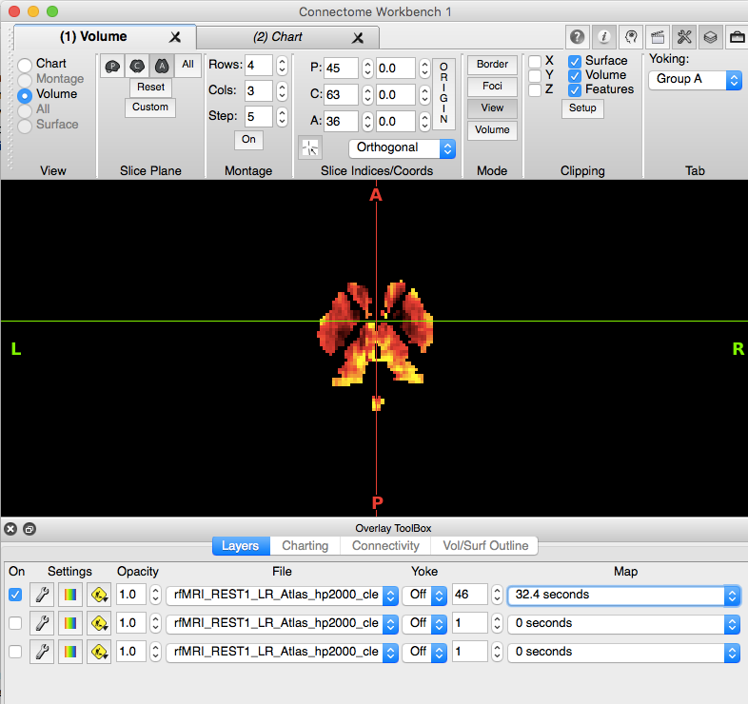
Human connectome
MRI data
Raw .nii file
Connectome Workbench
MRI through time

Slide 26
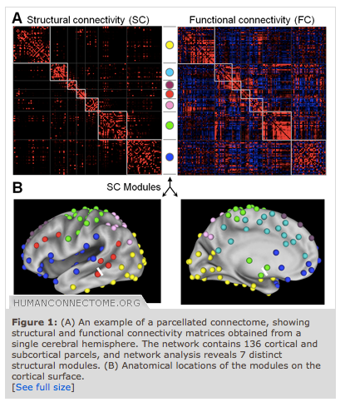
Human connectome
Network Modeling
Tools to find connections

Slide 27
human connectome
STATE OF THE ART
Artifact removal in the context of group ICA: A comparison of single-subject and group approaches
Predicting Activation Across Individuals with Resting-State Functional Connectivity Based Multi-Atlas Label Fusion
Abnormal striatal resting-state functional connectivity in adolescents with obsessive-compulsive disorder
Subdivision of Broca's region based on individual-level functional connectivity
http://www.humanconnectome.org/about/publications-using-hcp-data.php

Slide 28
Human connectome
POSSIBLE RESEARCH QUESTIONS
Can we find temporal correlations in activation (via task-fMRI data) in brain regions for certain tasks? Are there sequences of activations in brain regions for certain tasks?
Brain parcellation—separate brain structures based on function a goal of the HCP
HCP is also trying to do multi-modal data integration (HARDI, r-fMRI, t-fMRI, MEG)

